Slide 1
Total Military Expenditure
Individual Project 1
DATS 6103 (Sec 10)

Slide 2
Data
Data is from the World Development Indicators published by the World Bank
Time range covers 1960 to 2016
Three variables were taken:
Military expenditure (% of GDP)
GDP (current US$)
Population, total
Further variables were created from these three
Convert into longitudinal dataset into to cross-sectional panel data
 |  | Military Expenditure per GDP | GDP | Population | Military Total Expenditure | Military Expenditure per Capita
Country Name | Years
Afghanistan | 2010 | 1.90 | 15936800636.25 | 28803167.00 | 302396449.47 | 10.50
 | 2011 | 1.78 | 17930239399.81 | 29708599.00 | 318905914.33 | 10.73
 | 2012 | 1.14 | 20536542736.73 | 30696958.00 | 235084908.44 | 7.66
 | 2013 | 1.05 | 20264253974.11 | 31731688.00 | 212778504.08 | 6.71
 | 2014 | 1.30 | 20616104297.67 | 32758020.00 | 267541047.58 | 8.17
 | 2015 | 0.99 | 19215562178.98 | 33736494.00 | 190897729.21 | 5.66
 | 2016 | 0.89 | 19469022207.64 | 34656032.00 | 173729131.95 | 5.01
Albania | 1960 | nan | nan | 1608800.00 | nan | nan
 | 1961 | nan | nan | 1659800.00 | nan | nan
 | 1962 | nan | nan | 1711319.00 | nan | nan
 | 1963 | nan | nan | 1762621.00 | nan | nan

Slide 3
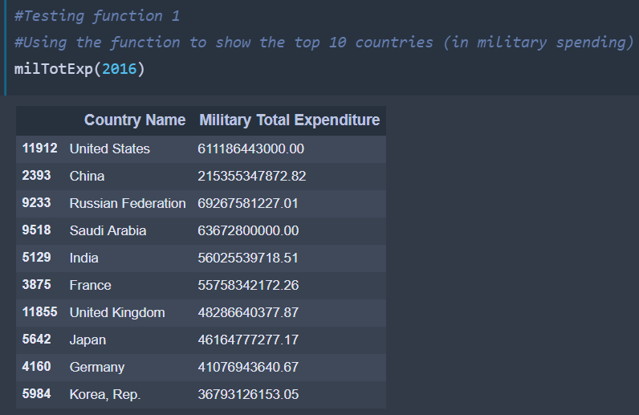
Function 1
Table sorted by 2016 total spending
Total spending
Per GDP spending
Proportion of top ten spenders
Per capita spending
Default shows country name and one variable sorted by 2016 total spending
Notes:
#Table of Top Countries
#Create function 1: Table sorting the top countries
#View countries sorted by military total expenditure with total military spending per GDP,
# percentage of military spending of the top ten, &
# total military spending per capita.
#Can show only country names sorted by any military total expenditure or the other three categories
#Can show only the amounts sorted by military total expenditure
#Can change the table row length from 10 to any other number (up to 219 countries/terrorities in dataset)

Slide 4
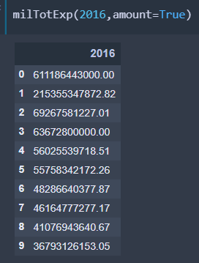
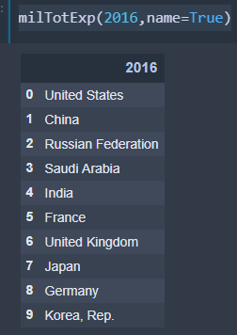
Function 1
Can show only the amounts sorted by 2016 total expenditure
Can show only country names sorted by any military total expenditure or the other three categories

Slide 5
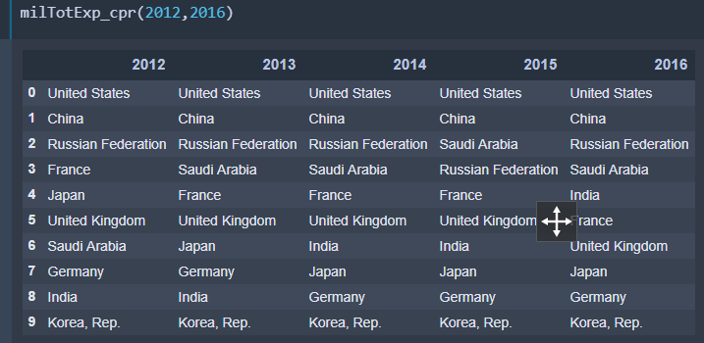
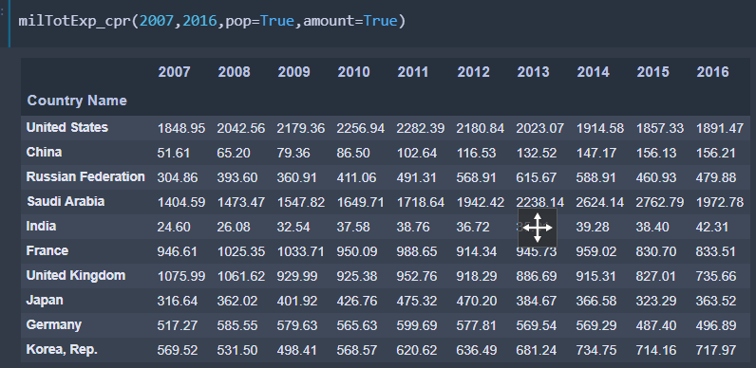
Function 2
Time range as columns
Table showing positional change of categories by country name
Values sorted by a variable Same 4 variables can be used
Time range can be any length
Notes:
#Table of Top Countries over Time
#Create function 2: Table showing positional change of categories using time range as columns
#View countries sorted by military total expenditure,
# total military spending per GDP,
# percentage of military spending of the top ten, &
# total military spending per capita.
#Can show only country names sorted by any military total expenditure or the other three categories
#Can show only the amounts sorted by military total expenditure
#Can change the table row length from 10 to any other number (up to 219 countries/territories in dataset)

Slide 6
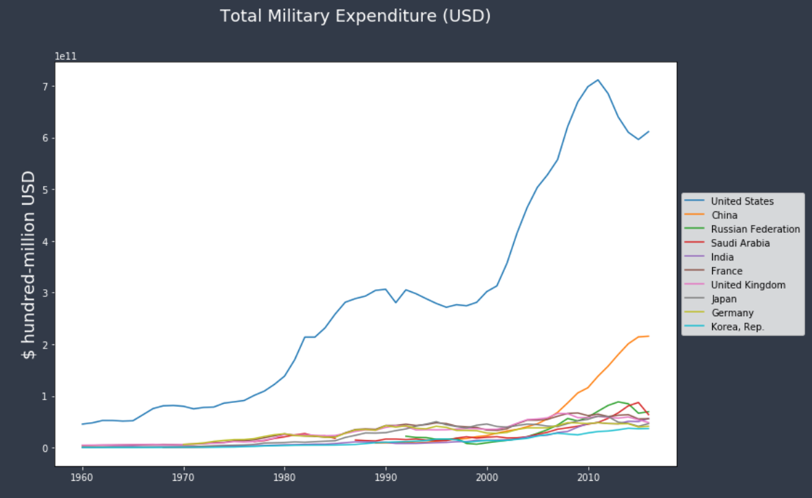
Function 3
Line graph showing of one of four variables
2 potential time ranges
from 1960 to 2016
or 2007 to 2016
Can define color of line
Can change the width of the lines
Notes:
#Line Graph of Top Countries
#Create function 3: Line graph showing country of input by one of 4 categories using 2 potential time ranges
#View countries by military total expenditure,
# total military spending per GDP,
# percentage of military spending of the top ten, &
# total military spending per capita.
#Can range from 1960 to 2016 or 2007 to 2016
#Can define color of line

Slide 7
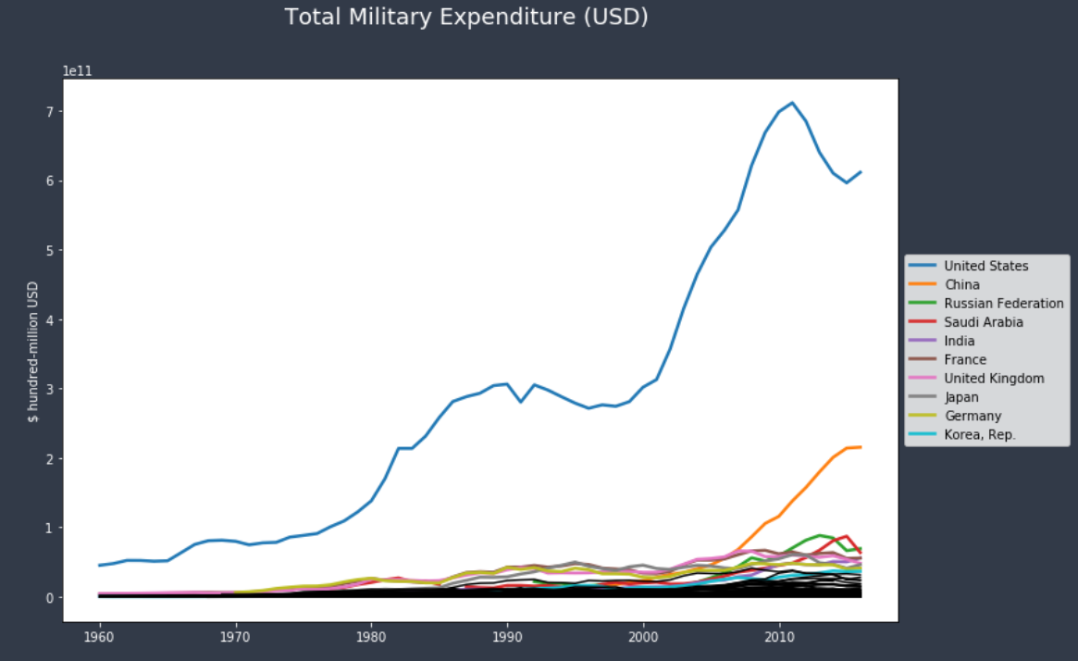
Top Ten Countries in Total Spending
The United States: largest spender and most volatile
Lower during President Clinton and President Obama’s tenure
Higher under President Reagan and President W. Bush
Added the other 209 countries in black

Slide 8
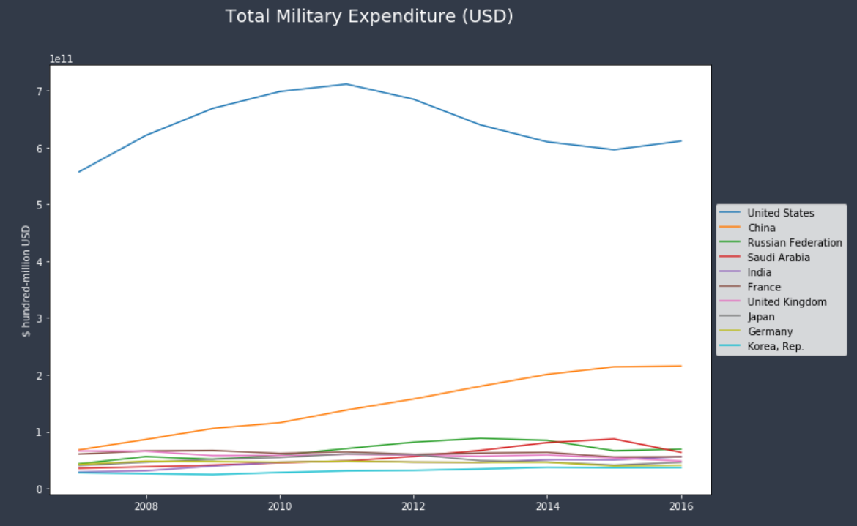
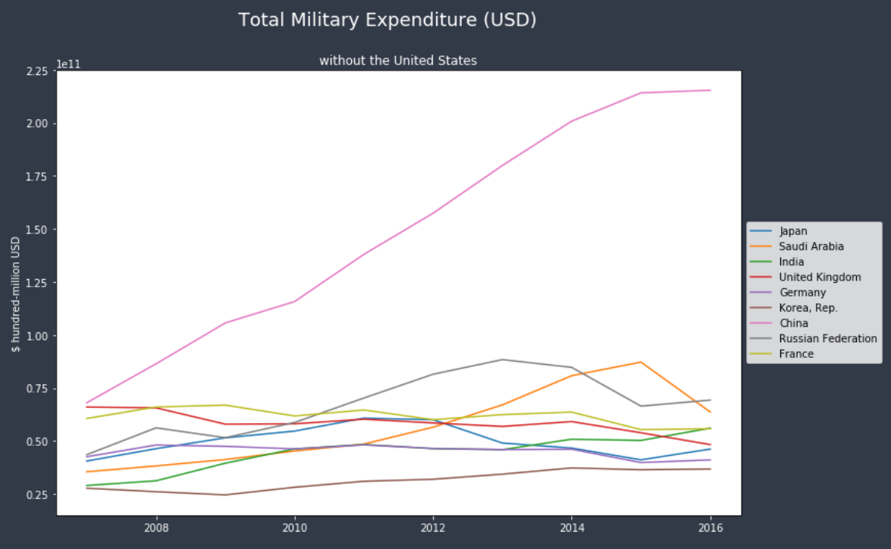
Top Ten Countries in Total Spending
Looking at only 10 years
United States is an outlier
China is dramatically grew in spending

Slide 9
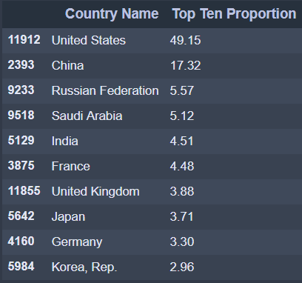
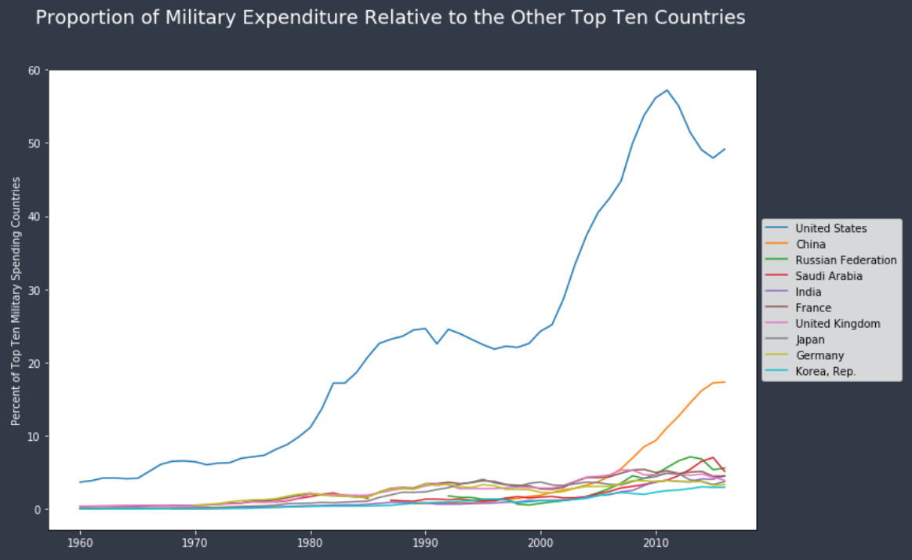
Proportion of Spending Relative to the Other Top Ten Countries
The United States possesses almost half of all military expenditure out of the top ten countries
Russia, the third largest spender, is almost 1/10th
Looks similar in graph-form to military total expenditure

Slide 10
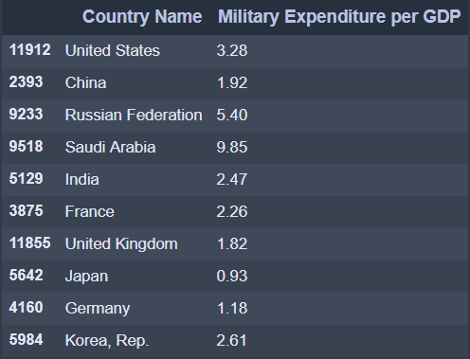
Per GDP Spending
The United States, number one in total spending, is only number three
Saudi Arabia is easily the highest
Russia is also very high
Japan is the only country below 1 percent

Slide 11
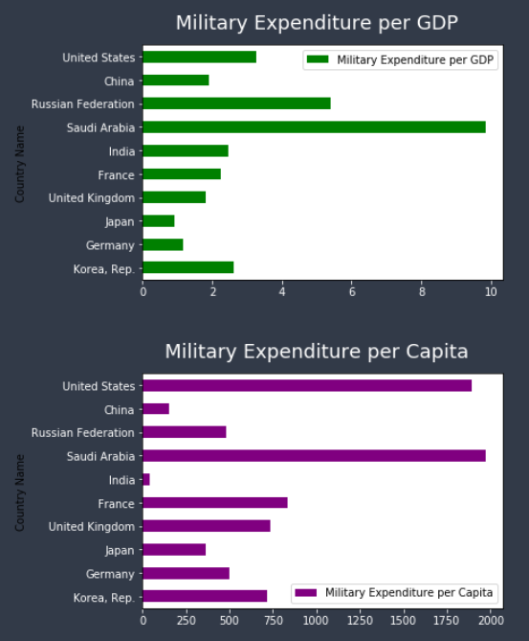
Military spending per GDP and per Capita
Saudi Arabia is easiest the highest in both per GDP and per person expenditure
Indicates that it routes far more of its resources to its military than other countries
The United States spends a lot per capita, but very little per GDP
Reveals that its GDP is high in absolute terms, but that its population is small relative to its military total expenditure

Slide 12
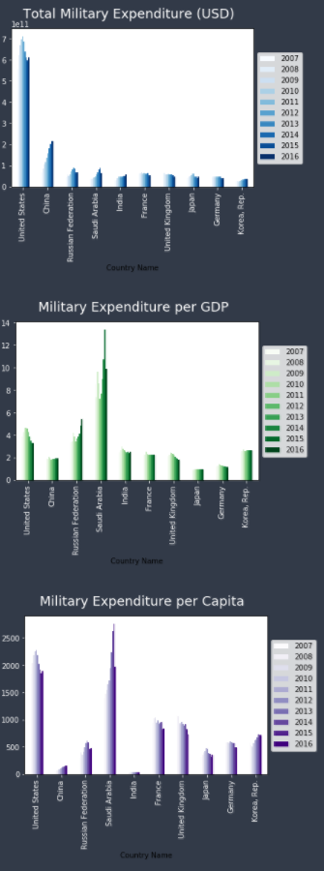
Conclusion: Over Time
The United States has declined in all cases
China, Russia, and Saudi Arabia are increasing in total spending
China has increased total spending and relative to the other ten countries
However, not per GDP or per capita
The small country of Saudi Arabia stands out as fourth in total spending
Because it is most aggressive in increasing spending relative to its economy and population

